Slide 1
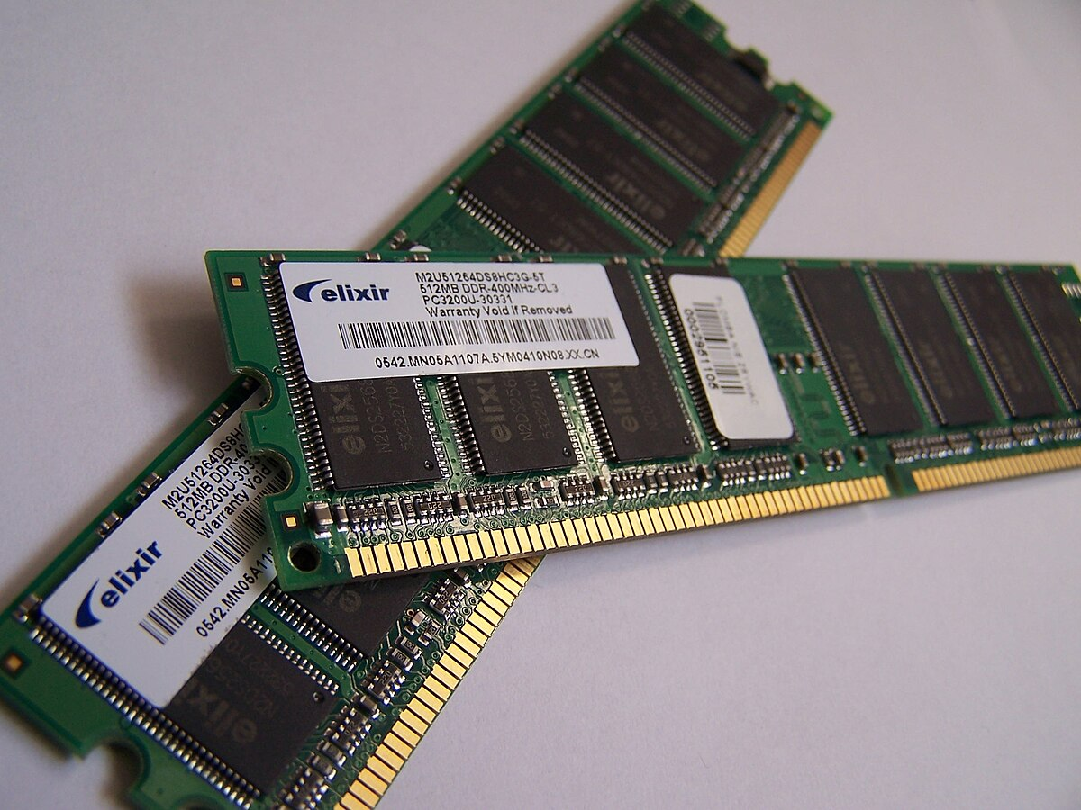
RANDOM ACCESS MEMORY (RAM) >computer peripheral Class
This Photo by Unknown Author is licensed under CC BY-SA

Slide 2
History:
The first form of RAM was developed in 1968.
Its primary purpose is to store data as electrically charged spots.
Through the early trials and errors of computer memory, the final result was Dynamic Random Access Memory which we use today in our devices.
Dynamic Random Access Memory or (RAM) was first invented in 1968 by ROBERT DENNARD.
His invention led to new era of technological advancements.

Slide 3
DEFINITION:
RAM(Random Access memory) is the place in a computer that typically resides on memory modules.
RAM is a computer’s short term memory, where the data that the processor is currently using is stored.
A RAM Memory chip is an integrated circuit made of millions of transistors and capacitors.
RAM is a volatile memory. (volatile means loses electrical charge when power goes off)
Whenever the computer is turned on again, the BIOS reads your operating system and related files from the hard disk and loads them back into RAM.

Slide 4
Types of ram:
Sram:
It stands for static random access memory.
SRAM stores information in transistors.
SRAM is on-chip memory where access memory is small.
SRAM is faster.
SRAM is expensive.
SRAM is available in smaller storage capacity.
Dram:
It stands for Dynamic random access memory.
DRAM stores information in capacitors.
DRAM is off-chip memory where access is large.
DRAM is slower.
DRAM is cheaper.
DRAM is available in larger storage capacity.

Slide 5
Types of ram
The construction of SRAM is complex due to the usage of the large number of transistors.
It does not be periodically refresh to retain its data.
Static RAM is mainly used to make the CPU’S Cache.
In SRAM, a single block of memory requires six transistors.
DRAM construction is simple to design and implement.
It needs to be periodically refreshed to retain its data.
Dynamic RAM is mainly used to make the main memory.
While in DRAM, it stores each bit of data in each capacitor within an integrated circuit.

Slide 6
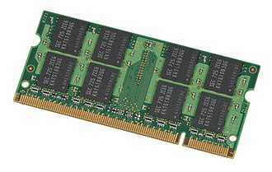
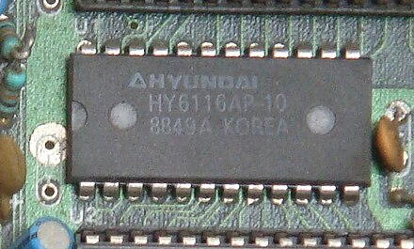
Here you go to see the pictures of SRAM and DRAM:
This Photo by Unknown Author is licensed under CC BY-SA
This Photo by Unknown Author is licensed under CC BY-SA

Slide 7
TWO TYPES OF DRAM:
SDRAM (synchronous dynamic random access memory)
DDR SDRAM(double data rate SDRAM)
SDRAM Is a High speed semiconductor memory.
It is an improved form of the older DRAM(dynamic random access memory)
SDRAM operates synchronously, which means that it operates in sync with the system data bus. Therefore it can operate at much greater speed than non synchronous RAM.
DDR SDRAM is an improved form of the SDRAM which allows a computer to transfer data at twice the speed.
It has improved memory clock speed as compared to simple SDRAM.
It reads and writes two consecutive words per clock cycle.

Slide 8
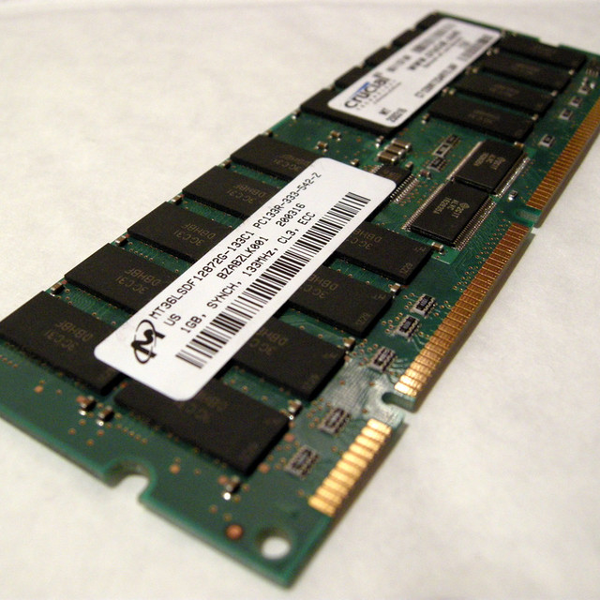
Here you go to see the pictures of SDRAM and DDR SDRAM:
SDRAM
DDR SDRAM
This Photo by Unknown Author is licensed under CC BY-SA
This Photo by Unknown Author is licensed under CC BY-SA

Slide 9
Types of ddr sdram: There are many types of DDR SDRAM used for computer’s today.
DDR1,DDR2 and DDR3 are the sub types of DDR SDRAM.
It’s ranging in speed from 100MHZ to 2000MHZ.
SDRAM comes in sizes of 512MB to 4GB for use in computers.
DDR2 and DDR3 RAMs are used in today’s computer.
DDR2 reads or writes 4 words per clock cycle.
DDR3 reads or writes 8 data words per clock cycle

Slide 10
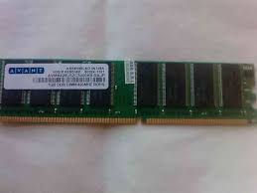
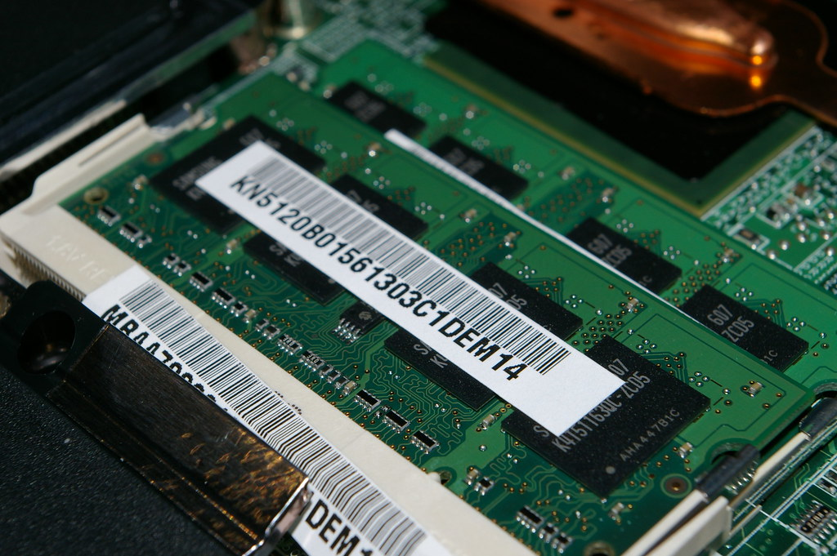
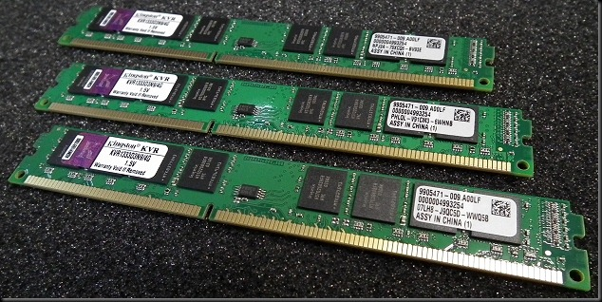
DDR1
DDR2
This Photo by Unknown Author is licensed under CC BY
DDR3
This Photo by Unknown Author is licensed under CC BY-SA-NC
This Photo by Unknown Author is licensed under CC BY-SA

Slide 11
Thank you…

